Slide 1


Troubleshooting Heating Plate HS-50F
--- Marcos Magalhaes
MIS Customer Service Department – Mindray Brazil

Slide 2
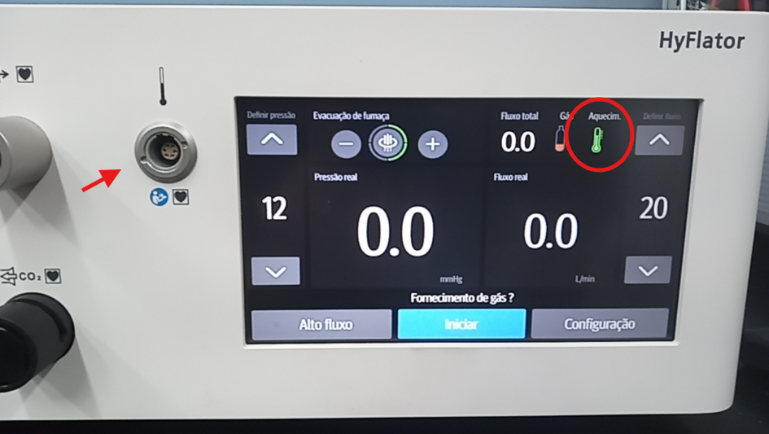
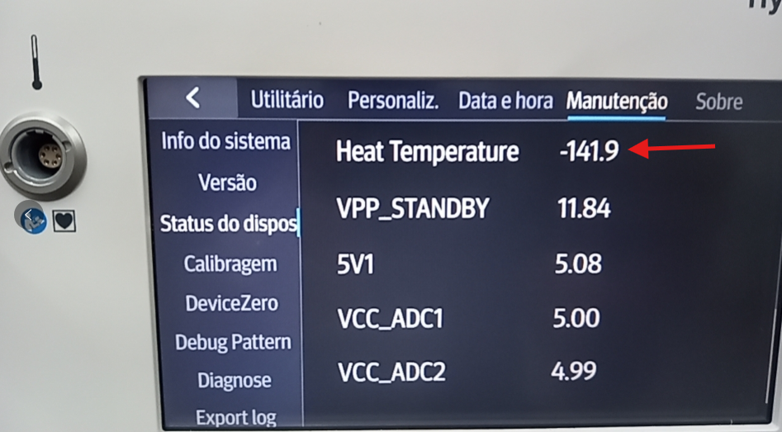

Defect
Background： When you turn on the insufflator, with the heating pipe disconnected, the heating icon remains on, and when you check the heating temperature in the service menu, there is a discrepancy, because the normal temperature is ~30°C.

Slide 3
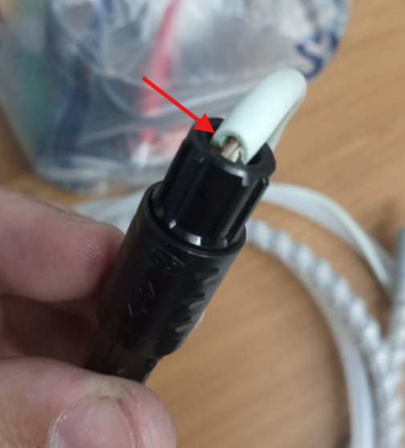
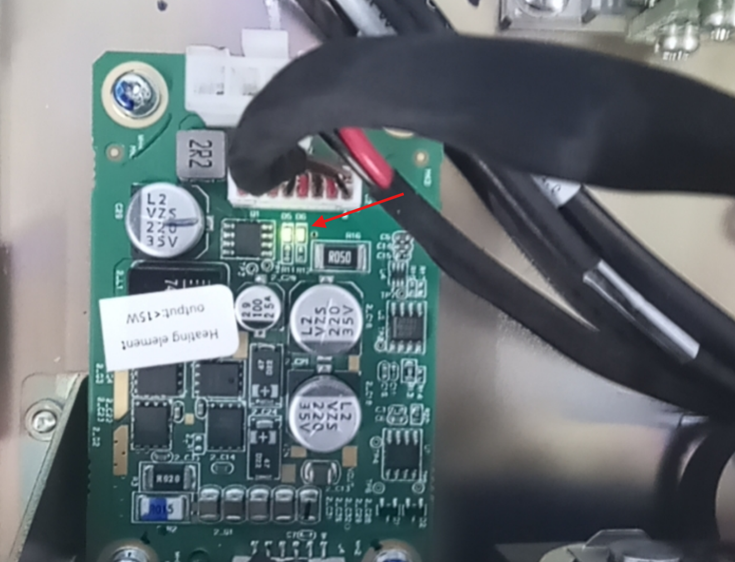
Previous Verification
Crosscheck required:
① Connecting the blower heating pipe:
Due to the use of the damaged cable, there was damage to
the on the heating plate, which is responsible for sending
data to the main board, with the connection of the heating
cable and measuring the temperature of the heating element.
It is therefore extremely important to check all the
circuit of the heating system.
② Checking LED D6 on the heating board :
Another point to check is whether the D6 LED on the heating
plate is on, even with the heating cable disconnected.
If it is, this is an indication that the heating plate is damaged.
**If one of these recommendations occurs, the heating plate should be replaced.**

Slide 4
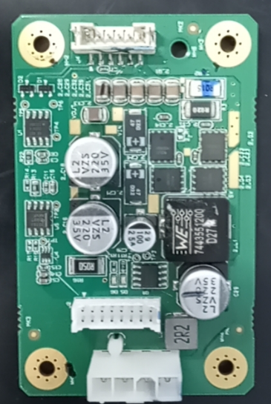
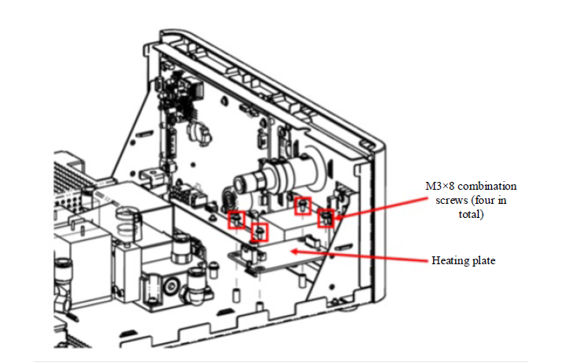
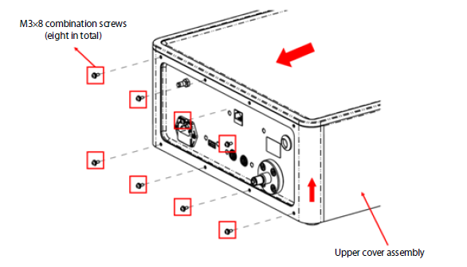
Repair Process
① Disconnect the equipment from the power supply.
② Remove the top cover:
Remove the eight M3 combination screws on the rear panel.
Pull the upper cover back in the direction indicated by the arrow until the entire upper cover assembly is released. Pull the upper cover assembly upwards in the direction indicated by the arrow to disassemble the upper cover assembly.
③ Disassembling the Heating Plate
Use a Phillips screwdriver to remove the four M3×8 combination screws as shown in the figure to remove the heating plate
PN 115-076021-00
Heating board FRU

Slide 5
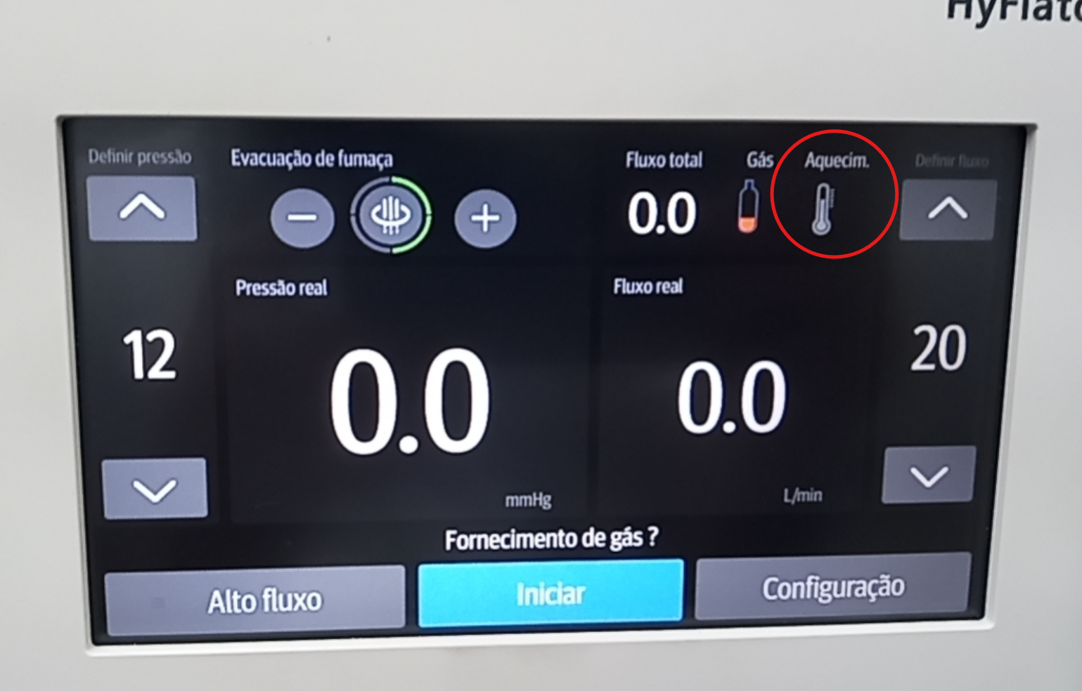
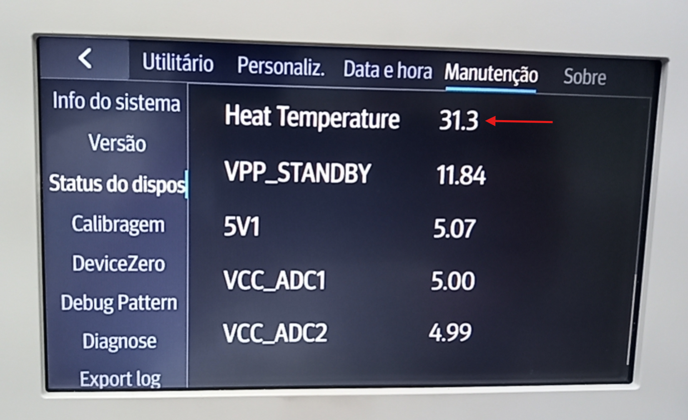

Check after upgrade
After replacement, assemble the unit, connect it to the power supply, the heating icon should be off as long as the heating cable is not connected. Also check in the service menu that the temperature without the cable connected is ~30°C.
**If it persists, check the Main Board and Power Module.**

Slide 6
Check after upgrade
After the previous step, please carry out the heating function test (according to section 7.4.4 of the service manual):
Tools
Heating insufflator tube (115-052867-00)
Test Procedure
1. Connect the gas source and power supply and ensure that the gas source pressure is not less than 0.4 MPa.
2. Start the insufflator and enter the standby state.
3. Connect the heating insufflator tube and start inflation.
4. After inserting the insufflator tube, the heating indicator will turn green. Touch the insufflator tube after 5 minutes, if it is slightly heated, the heating function test is passed.

Slide 7
Thank you！
Notes:
That’s all.

